Slide 1
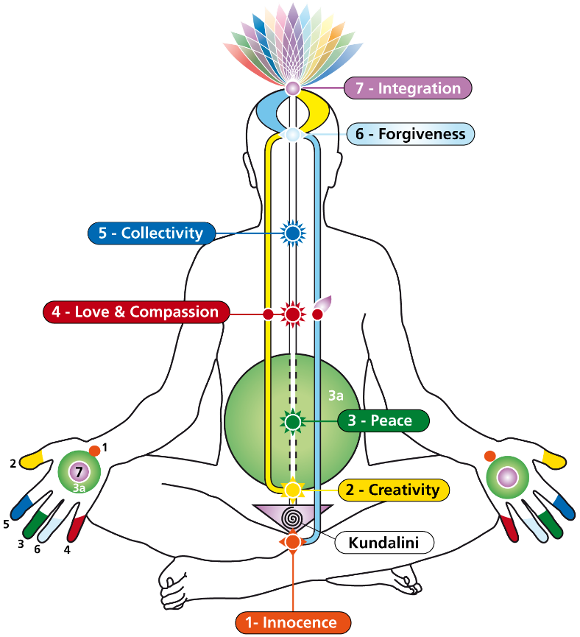
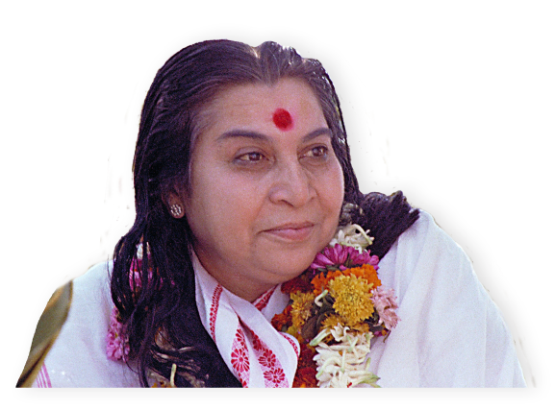
The Void the Guru Principle
The Void
‘Now here Mother has given me the Spirit and I have my own Guru which is the Spirit. I am master of my own. Let there be no abandonment, let there be dignity in my character.’

Slide 2
The Void

Slide 3
The Void

Slide 4
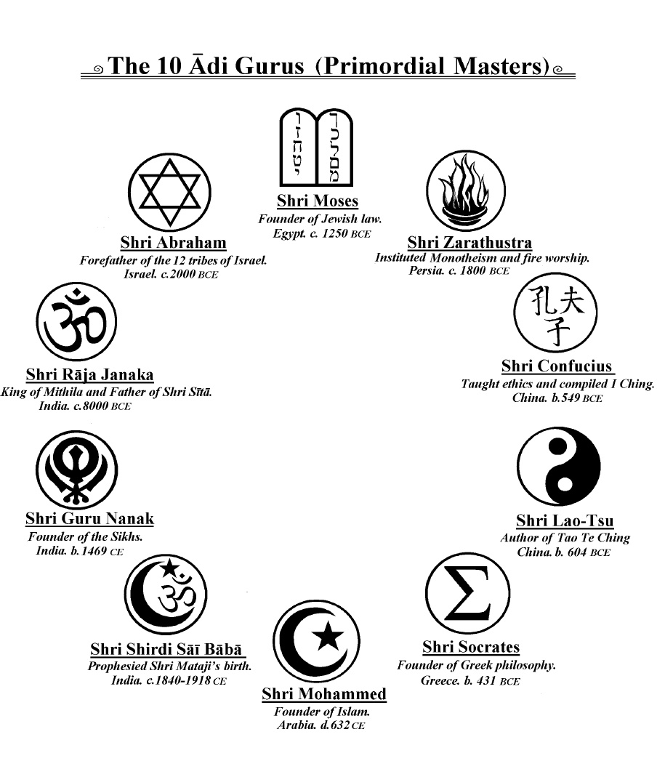
The 10 Primordial Masters (Adi Gurus)
Raja Janaka
5000 BC, Mithila, India
Abraham
2000 BC Mesopotamia
& Palestine
Moses
1200 BC, Egypt & Palestine
Zarathustra (Zoroaster)
1000 BC, Persia
Confucius (Kong-Zi)
551-479 BC, China
Lao-Tse (Lao-Zi)
6th century BC, China
Socrates
469-399, Athens Greece
Prophet Mohammed
570-632 AD, Mecca, Arabia
Guru Nanak
1469-1539 AD, Punjab, India
Shrī Shirdī
1838-1918 AD, Shirdi, India

