Slide 1

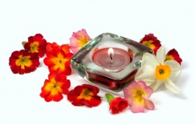
Welcome!
Sahaja Yoga Meditation
An opportunity to learn, experience and deepen
...a time to enjoy the peace of true meditation

Slide 2
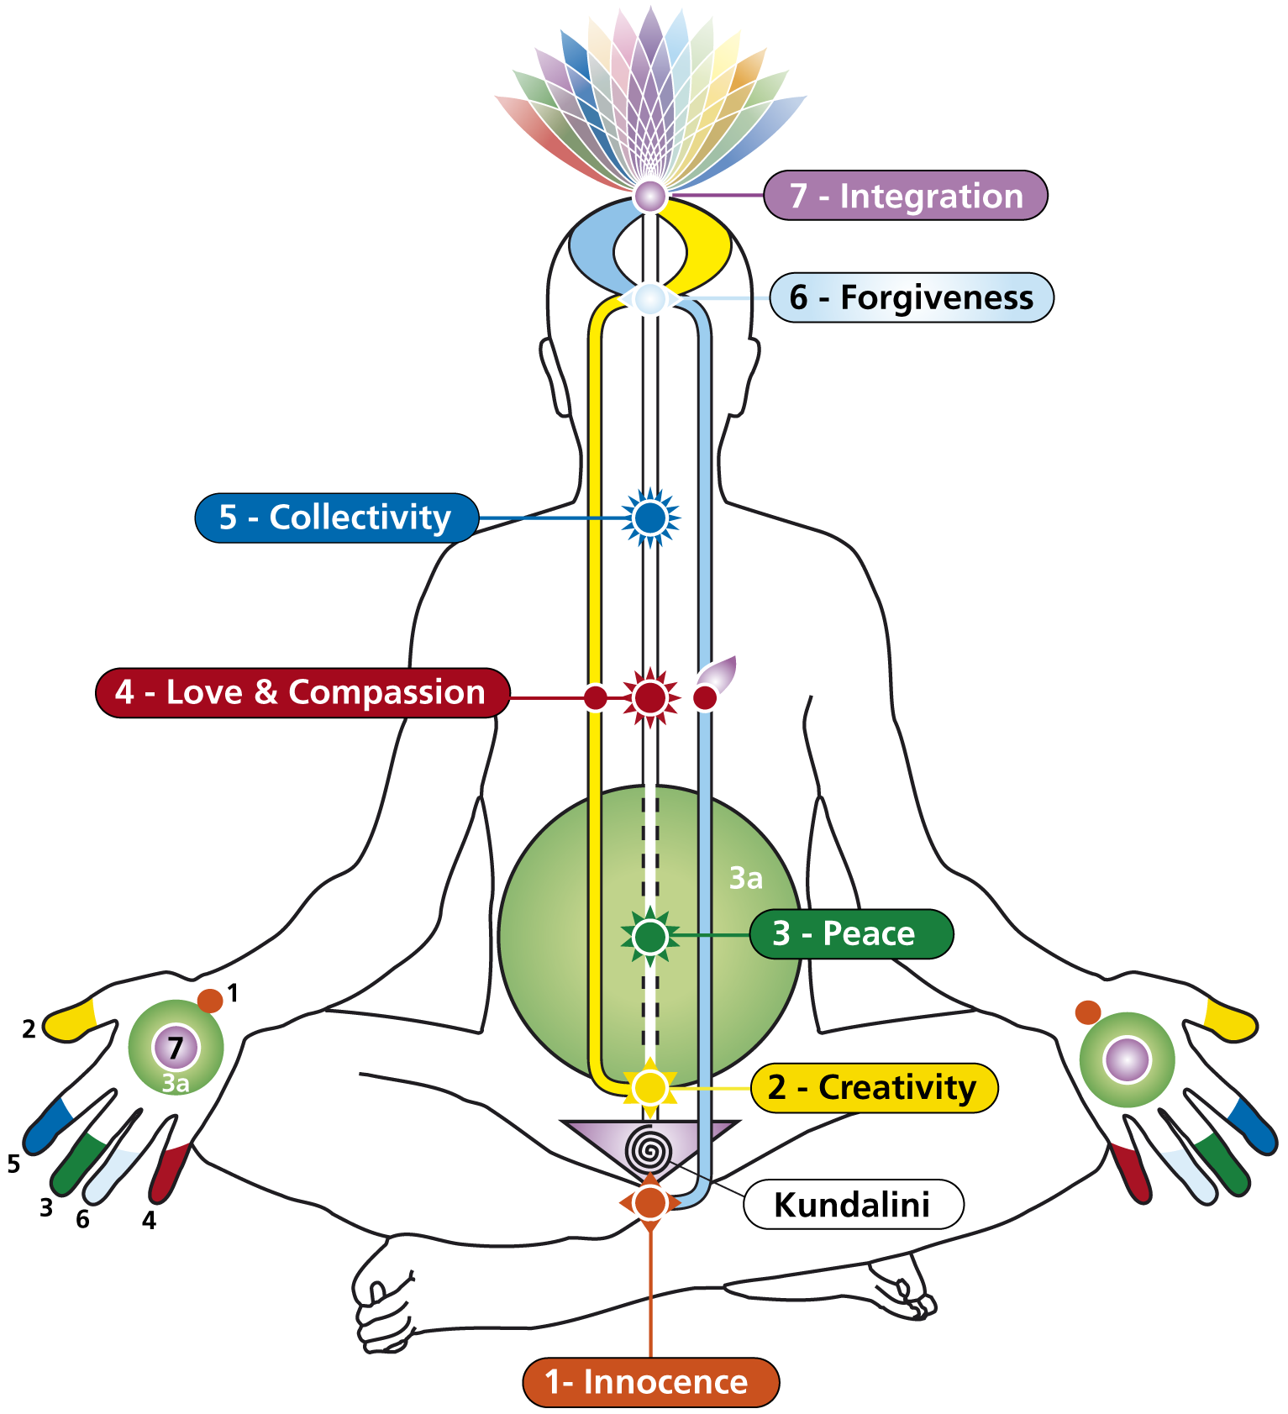
The Subtle System

Slide 3

The Subtle System
Right Channel
(Future, Activity & Planning)
Left Channel
(Past , Desires & Emotions)
Centre Channel
(Present, Evolution & Joy)

Slide 4

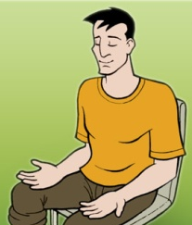
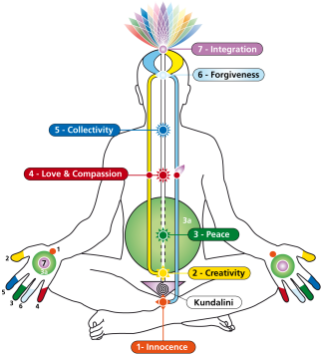
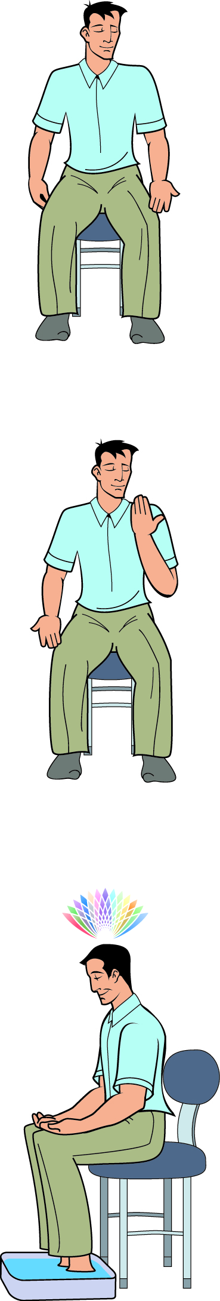

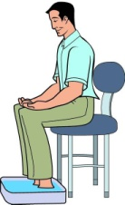
The Meditation
Meditation
Talks
Clearing
&
Balancing
Knowledge
On meditation and our subtle system
Techniques to enhance meditations
About our inner subtle system and why meditation helps

Slide 5
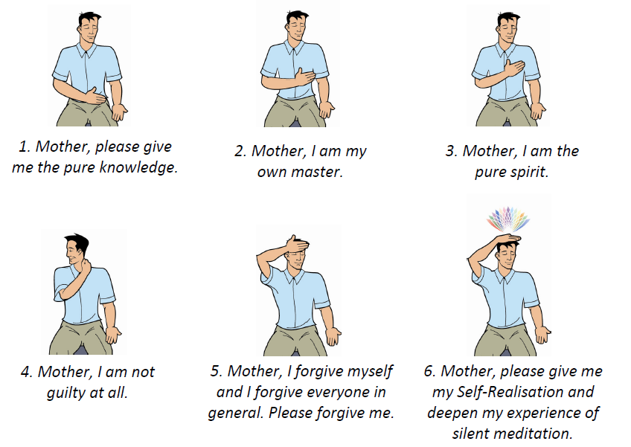
Affirmations

Slide 6
Clearing the Left Side
(Over emotional and dwelling in the past)
For tingling, heat or heaviness on the left hand:
• left hand on lap, palm upwards.
• place the right hand on the earth, or direct it towards the earth.
Clearing the Right Side
(Over planning and excessive mental or physical activity)
For tingling, heat or heaviness on the right hand:
• right hand on lap, palm upwards.
• bend the left arm at the elbow and direct the palm towards the back.

Slide 7
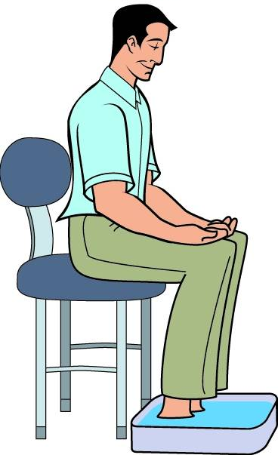
Footsoaking
Best done at the end of the day.
• Sit comfortably in a chair with hands on lap, palms upwards.
• Place feet in a bowl of cool to warm water with a handful of table salt.
• Meditate for around 10 to 15 mins.
• Rinse and dry feet. Flush water down the toilet and wash hands.

Slide 8

The Subtle System
Names of
Chakras
Sahastrara
Agnya
Vishuddhi
Heart
Nabhi
Void area (3a)
Swadisthana
Mooladhara

Slide 9
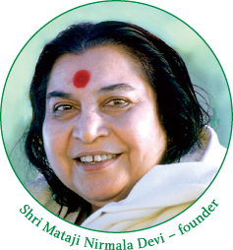
Background...
• Sahaja Yoga Meditation technique devised by Shri Mataji in 1970.
• Practised in over 90 countries.
• Classes always offered free of charge.

Slide 10
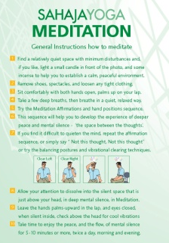
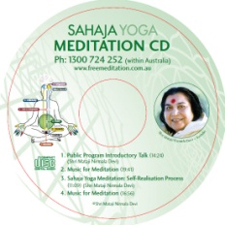
Weekly topics…
• Introduction to meditation and the subtle system.
• Guided meditation.
• Video Talk & balancing meditation.
• The Chakras.
• Meditation.
• How to meditate at home.
• Take-home information and meditation kits.

Slide 11

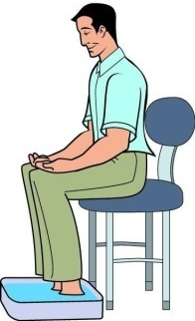

Class elements
MEDITATION
Guided and silent meditations.
TALKS (video/audio) by Shri Mataji, founder
Talks on meditation and our subtle system.
CLEARING & BALANCING
Techniques to enhance meditations.
KNOWLEDGE
Learn about our inner subtle system
and why meditation helps.

Slide 12
Elements to deepen meditation
Meditation
Talks
Clearing
&
Balancing
Knowledge

Slide 13
Introduction to meditation

Slide 14

Chakras...
• Energy centres, which are the source of human qualities (such as love, innocence, forgiveness).
• Discovered thousands of years ago through meditation and mystical experiences.
• Govern our wellbeing… physical, mental, emotional and spiritual.
• Located along the spine.

Slide 15
The Subtle System

Slide 16
The Subtle System
Right Channel
(Future, Activity & Planning)
Left Channel
(Past , Desires & Emotions)
Centre Channel
(Present, Evolution & Joy)
2
5
3
6
4

Slide 17
The Subtle System
Names of
Chakras
Sahastrara
Agnya
Vishuddhi
Heart
Nabhi
Void area (3a)
Swadisthana
Mooladhara

Slide 18
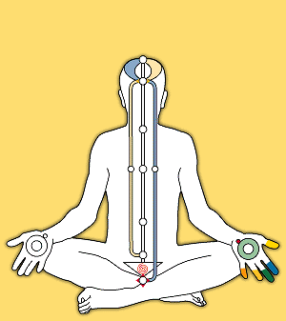

Slide 19
Balancing
&
meditating at home

Slide 20
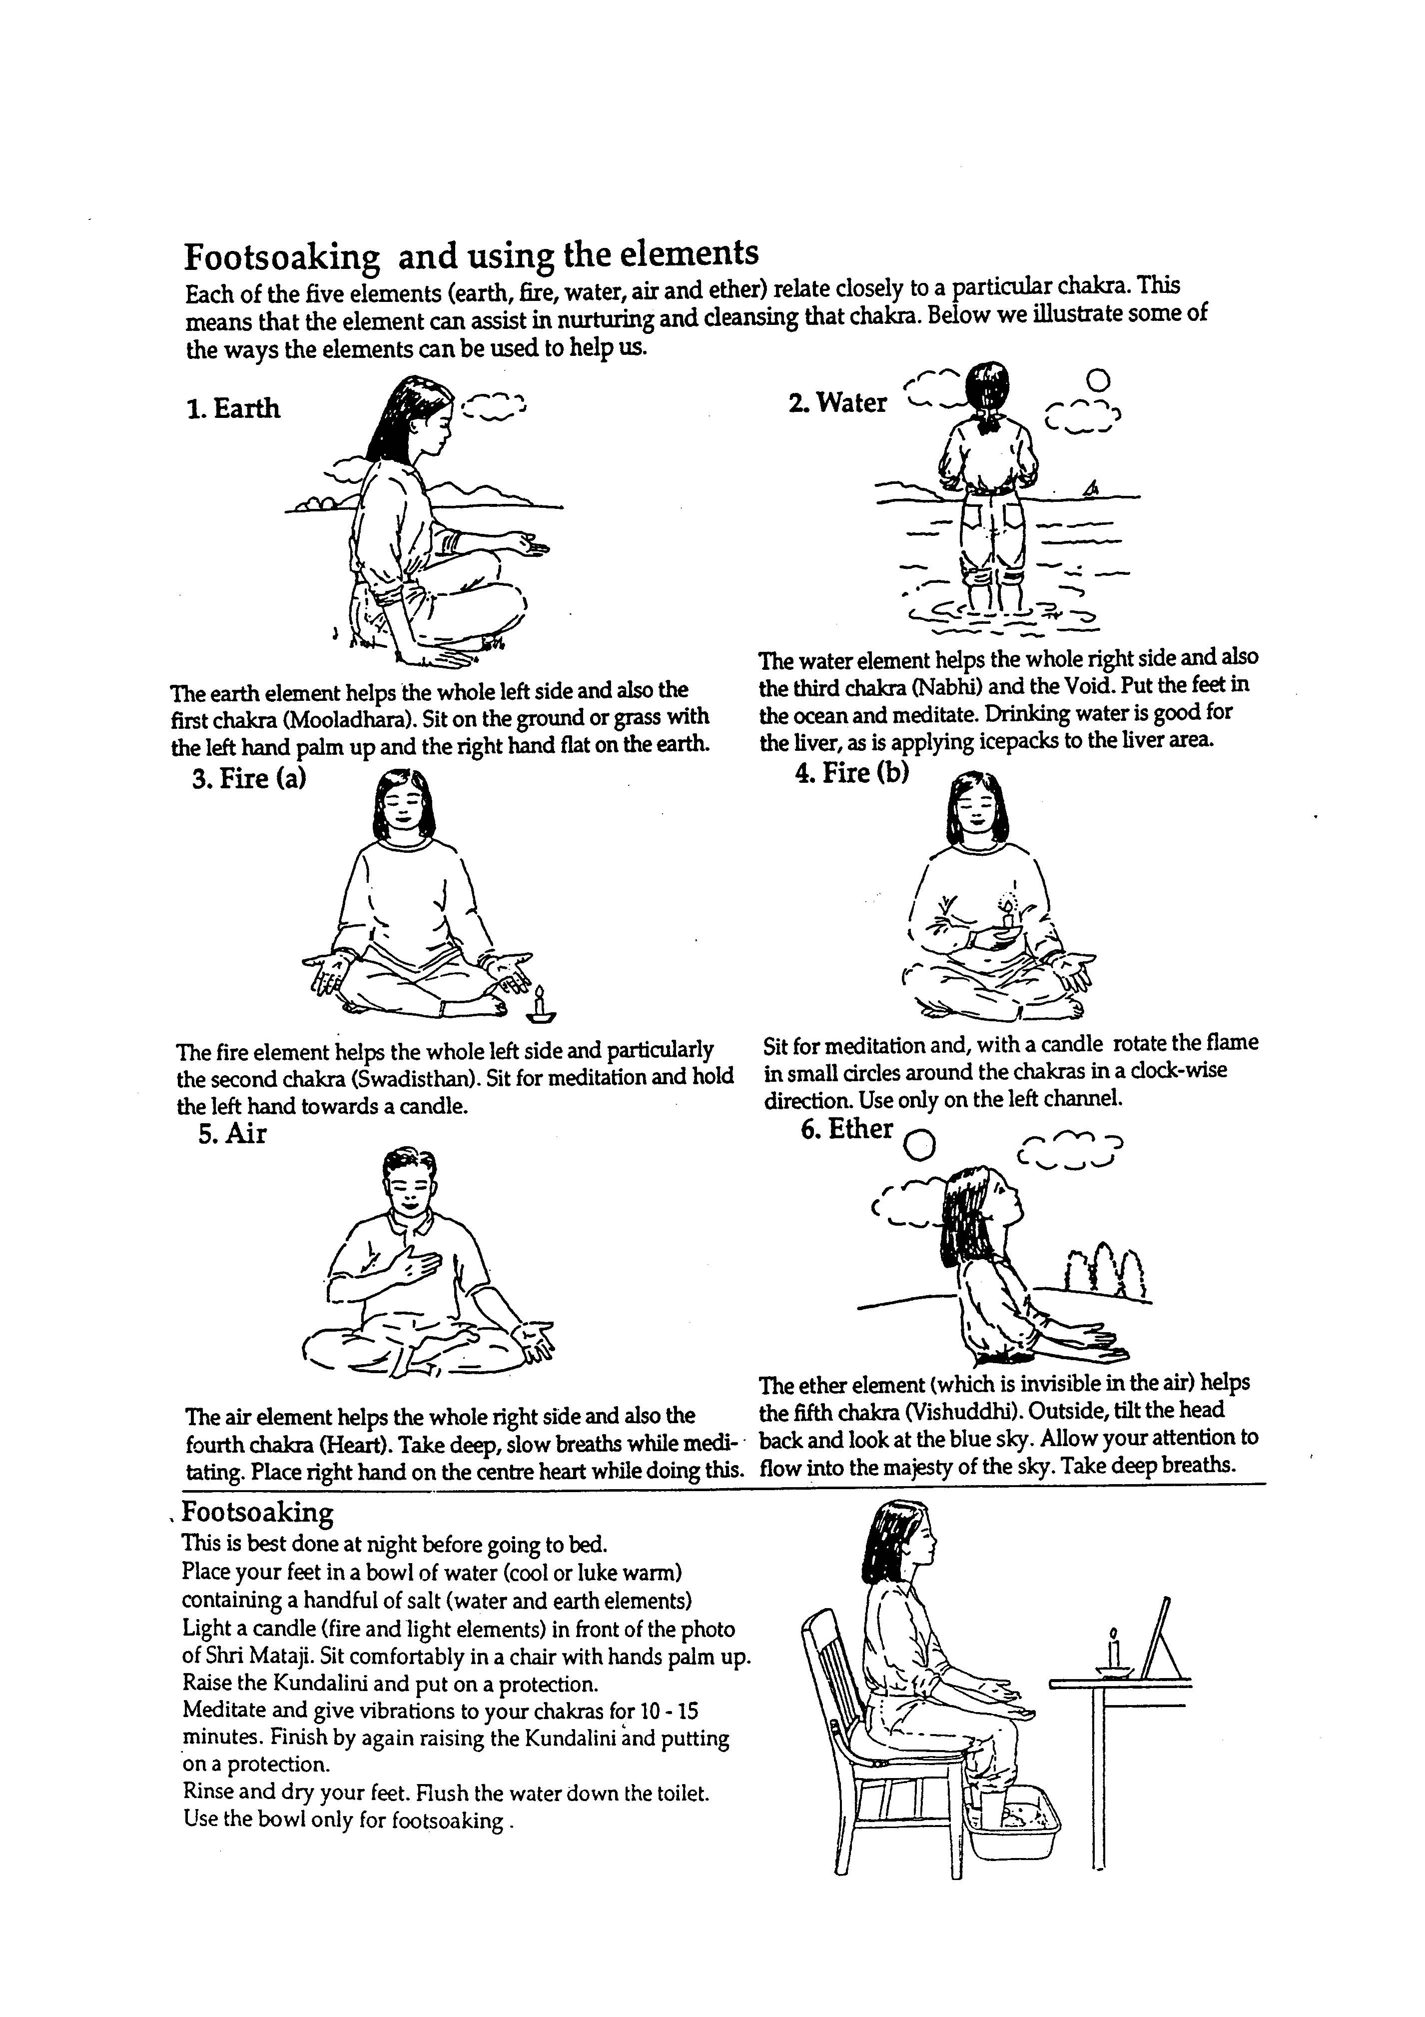
Clearing using the Elements
Each of the five elements (earth, fire, water, air and ether) relate closely to a particular chakra of the subtle system. This means that the element can assist in nurturing and cleansing that chakra. Below we illustrate some of the ways the elements may be used to help the subtle system. Remember to use moderation, don’t be rigid with any techniques. See what works for you - eg if you can’t sit on the ground, use a chair.
1. Earth
The Earth elements helps the whole left side and also the first chakra (Mooladhara). Sit on the ground or grass, with left hand palm up and the right hand flat on the earth.
2. Water
The Water element helps the whole right side and also the third chakra (Nabhi) and the Void. Put the feet in the ocean and meditate. Drinking water and applying an icepack to the liver area may help in cooling the right side.
3. Fire (a)
The Fire element helps the whole left side and particularly the second chakra (Swadisthan).
To clear the left side, sit for meditation and hold the left hand towards a candle. Always use care not to have candles too close.
4. Fire (b)
To clear chakras on the left side, sit for meditation and with a candle carefully rotate the flame in small circles around the chakra in a clock-wise direction. Use candles only on the chakras on the left channel.
5. Air
The Air element helps the whole right side and also the fourth chakra (Heart). Pay attention to your breathing, gently taking a few deep breaths. Place right hand on the centre heart while doing this.
6. Ether
The Ether element (which is invisible in the air) helps the fifth chakra (Visshuddhi). Outside, tilt the head back and look at the blue sky. Allow your attention to flow into the majesty of the sky and take some deep breaths.

Slide 21
Tips for staying in balance
during the day…
• Daily meditation.
• Looking at the sky, mother earth, nature.
• Close eyes, bring the attention inside & top of head.
• Hand and attention on the left heart, the Spirit.
• Raise the kundalini.
• Take attention to breathing. Awareness of breathing.

Slide 22
Sahaja Yoga Meditation
freemeditation.com.au

Slide 23
Knowledge of the Chakras
Sahaja Yoga Meditation
freemeditation.com.au

Slide 24
Chakras...
• Energy centres, which are the source of human qualities (such as love, innocence, forgiveness).
• Discovered thousands of years ago through meditation and mystical experiences.
• Govern our wellbeing… physical, mental, emotional and spiritual.
• Located along the spine.

Slide 25
The Subtle System

Slide 26
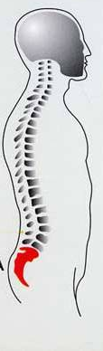
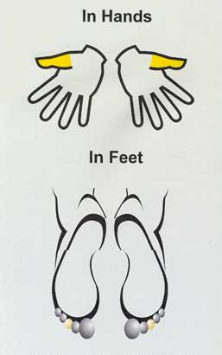
The Subtle System & Chakras
In Hands
In Feet

Slide 27
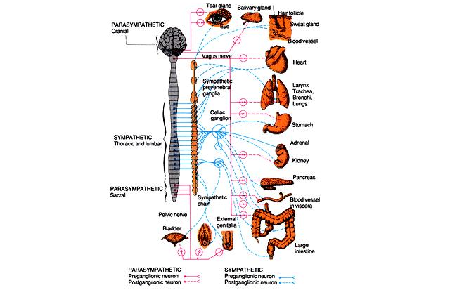
The Subtle System &
The Autonomic Nervous System
Notes:
27

Slide 28
Mooladhara Chakra
In Hands
In Feet
Pelvic
Plexus

Slide 29
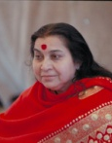
Mooladhara Chakra
Colour | Coral red
Element | Earth
Planet | Mars
Day | Tuesday
Stone | Coral
Quality | Innocence of an eternal child, Wisdom
Organs | Reproductive & excretory organs
Region | Australia (Uluru)
“Mother Earth is the one who is symbolised
within us as the Mooladhara.”

Slide 30
Swadisthana Chakra
In Hands
In Feet
Aortic
Plexus

Slide 31

Swadisthana Chakra
Colour | Yellow
Element | Fire
Planet | Mercury
Day | Wednesday
Stone | Amethyst
Quality | Pure Knowledge, Creativity, Aesthetics
Organs | Liver, Kidney, Uterus, Pancreas
Region | Africa
“To satisfy Swadisthan, you have to take to silence. You have to take to quietude and look at yourself. What is bothering you, what is troubling you, what gives you ideas and thoughts is Swadisthan.”

Slide 32
Nabhi Chakra
In Hands
In Feet
Solar
Plexus

Slide 33
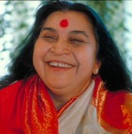
Nabhi Chakra
Colour | Green
Element | Water
Planet | Jupiter
Day | Thursday
Stone | Emerald
Quality | Seeking, peace, generosity, satisfaction, pure attention, looking after others
Organs | Stomach, Intestines, Liver, Spleen
Region | Europe
“It's such a satisfaction you derive from the Spirit. So you know the absolute truth, your attention becomes enlightened and thirdly you enter into the realm of joy.”

Slide 34
Void (combination Swadisthana & Nahbi)
In Hands
In Feet
Solar
Plexus

Slide 35
Void (combination Swadisthana & Nahbi)
Colour | Green
Element | Water
Day | Thursday
Quality | Self mastery (guru principle)
Organs | Abdominal organs
“Everything is within you. As soon as the light
comes, you can see everything.”

Slide 36
Heart Chakra
In Hands
Cardiac
Plexus
In Feet

Slide 37
Heart Chakra
Colour | Ruby Red
Element | Air
Planet | Venus
Day | Friday
Stone | Ruby
Quality | Joy, Compassion, Security, Love, Responsibility
Organs | Heart, Lungs, Blood Pressure
Region | England
“Unless and until you find your absolute in your heart or your wholesomeness, you can never be happy.”

Slide 38
Vishuddhi Chakra
In Hands
Cervical
Plexus
In Feet

Slide 39
Vishuddhi Chakra
Colour | Blue
Element | Ether
Planet | Saturn
Day | Saturday
Stone | Sapphire
Quality | Diplomacy, Collectivity, Communication, Witness state, Respect for self & others
Organs | Thyroid, Ears, Nose, Throat, Mouth, Teeth, Tongue, Face, Hand sensitivity
Region | America
“You have to just witness, witness the whole thing. Once you start witnessing, you'll be amazed that you will start seeing the play.”

Slide 40
Agnya Chakra
Optic
Chiasma
In Hands
In Feet

Slide 41
Agnya Chakra
Colour | White
Element | Light
Planet | Sun
Day | Sunday
Stone | Diamond
Quality | Forgiveness
Organs | Eyes
Region | China and Russia
“The divine love is the ocean of forgiveness, and whatever mistakes you might have committed can be easily dissolved by that ocean of forgiveness.”

Slide 42
Sahastrara Chakra
Brain or
Limbic Area
In Hands
In Feet

Slide 43
Sahastrara Chakra
Colour | All
Element | All
Planet | Pluto
Day | Monday
Stone | Pearl
Quality | Integration and Self Realisation, Thoughtless Awareness, Union (yoga)
Organs | Limbic area
Region | Himalayas
"Unless and until you know yourself, unless and until there is self knowledge - your confusion cannot disappear."

Slide 44
Sahaja Yoga Meditation
freemeditation.com.au

